Slide 1
GAM 245
Part III:
Simple Models in Maya

Slide 2
Getting Started With Maya
If you have the LAM book, it’s not a bad idea to go through their training steps
    Practice with use their ‘Lessons’ at the beginning of the book
      For the 2009 edition: LAM’s “lesson 01” chapter, p47-69
        create a Great Hall with column and throne
      For the previous edition: LAM’s “lesson 01" chapter, p40-61
        create the garage, shelves, boxes, lamp
    Skip all the NURB elements since we will only use polygon models.
    Keep going with lessons 02, 03, 04. This will cover all the basics you’ll need.
    Do not hide UI elements as requested by lesson 03 We don’t need the extra trouble!
I’ll cover the basic minimum you’ll need to make models for this class.
  However, Maya is not easy.
    It’ll take some time and practice to get comfortable
Create a test directory for your experimental Maya work
  Keep your class directories clean
  Experimental work should not be sent send to SVN
  But you should keep copies of the various stages of your experiments
      That way you have a way to go back to previous ‘steps’ in case something goes wrong…

Slide 3
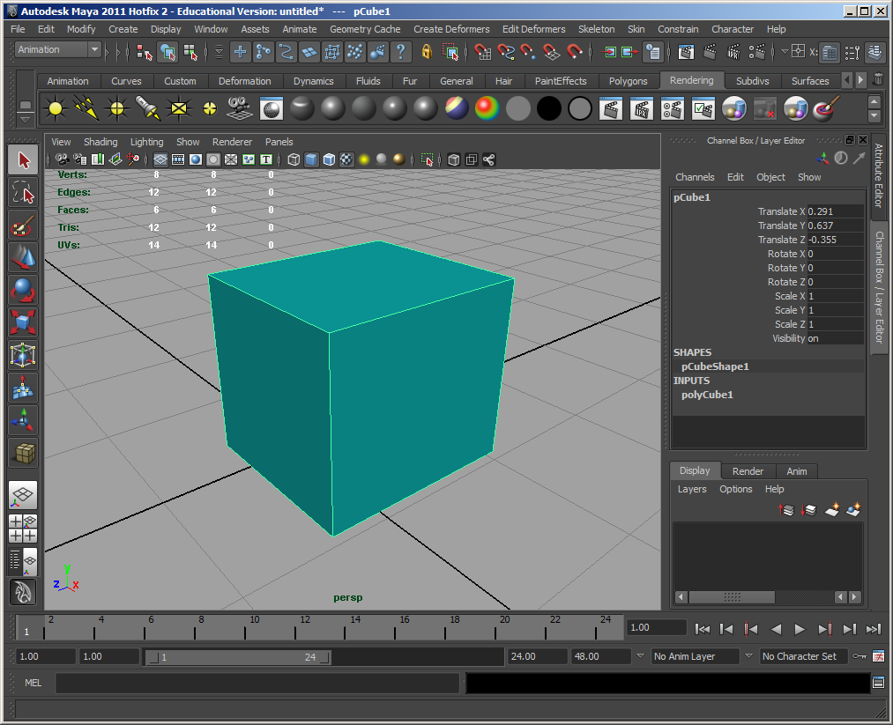
Making a box in Maya

Slide 4
Models:
General Info
3D Coordinates (RHS)‏
  use your right hand
  extend your thumb to your right, then pointer finger up, then middle finger toward you
  thumb = X, pointer = Y, middle = Z
  X is always red, Y is green, Z is blue
Always build your models in 000ZY form
  000 means that the model's root (rotation / scaling / pivot) is at 0,0,0
  Z means model is facing in positive Z
  Y means Y is up for model
Units / Scaling
  We need to chose a size correspondence between Maya and XNA spaces
    one Maya unit = one unit in our game worlds
    Note for blender user: you’ll need to significantly scale down your model while in blender

Slide 5
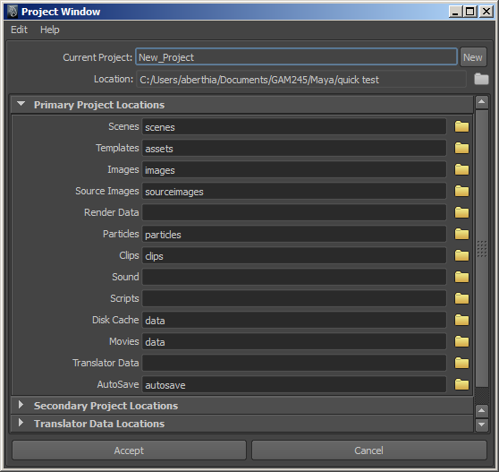
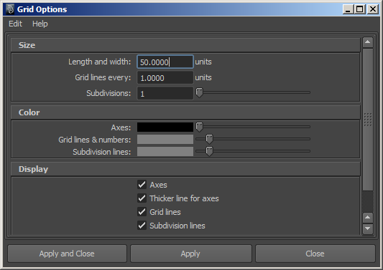
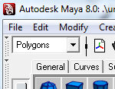
Maya:
Preparing the Environment
Set the project folder
  File > Project window
    Enter location name and click ‘accept’
Setup Grid
  Display > Grid []
  one Maya unit = 1 foot
Set Polygons mode

Slide 6
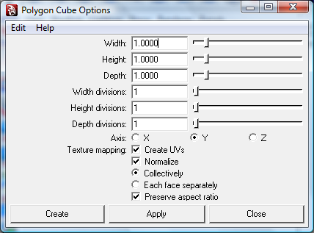
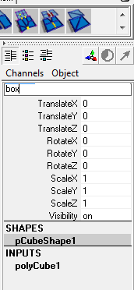
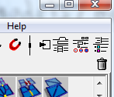
Create Polygon Cube
Use only polygons
Create > Polygon Primitives > Cube []
create a 1x1x1 cube
click this diagram to open the channel box
Use the Channel box to rename the cube to “box”
Also:
keys ‘4’ and ‘5’: to flip between shaded and wireframe

Slide 7
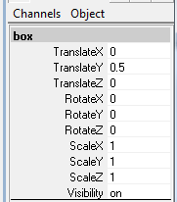
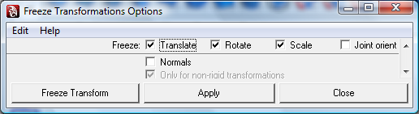
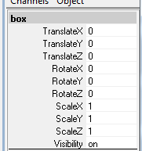
Move & Freeze Geometry
1. Move the cube up so it rests on the ground
2. Modify > Freeze Tranformations []
this 'bakes' the transform changes into the geometry
3. Notice channels have all been reset

Slide 8
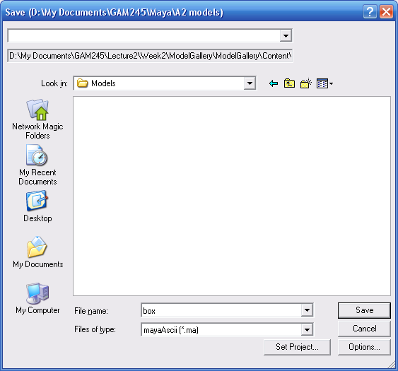
Delete History and Save
1. Edit > Delete All By Type > History
  this forces geometry into polygons and is very important
2. File > Save..
save your model in your
dev/245/NAME/MyContent/models
folder
    you may need to create the models directory

Slide 9
Applying a Texture
(Maya experts need to read this!)
Maya has the ability to create very complex and elaborate textures!
  marble, image mappings, wood grains, etc.
Almost all these CANNOT be used by a game engine (any game engine)
  Typically, the most you can expect is
    Applying a solid color
    Applying a texture on a model
      Think of this as wrapping a square image onto a model
HOWEVER, there is a way to use those great Maya textures: Baking!
  Specifically:
    In Maya, create a fancy texture of your choice on your models
    When done, save the texture to a single image file (baking)
    Change the model so that it applies the image file to itself instead of your initial texture.
  How can we bake a fancy texture to a file?
  Using Maya’s 3D paint tool

Slide 10
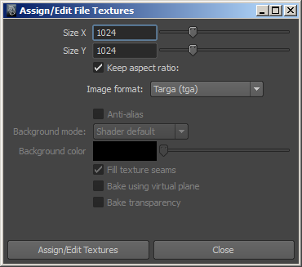
Using the 3D paint tool:
Step 1: Preparing the 3D Paint Tool
You may also wish to read Read about the 3D Paint Tool in LAM, 228-234.
Select the object you wish to texture
  Warning: Omitting this step is the most common mistake to make
Change the top menu from ‘Polygon’ mode to ‘Rendering’ mode.
Select Texturing/3D Paint Tool/ []
From the panel on the right, scroll down to the ‘File Texture’ section
Make sure that ‘Attribute to paint’ is set to ‘color’
Click ‘Assign/Edit Texture’
  Select a size (1024x1024 is a good one to start for now)
  Image format must be Targa (tga).
  Click ‘Assign/Edit textures’

Slide 11
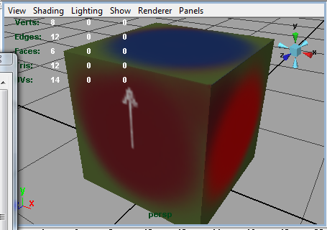
Using the 3D paint tool:
Step 2: Creating a Texture
Maya expert may now chose to create a fancy texture and move on to Step 3.
For us non-expert, we will simply ‘paint’ our texture.
  From the side panel, scroll up to ‘Color’ and select a color.
  Moving the mouse over the object, you can paint the object
    You may also change the brush size and other attributes using the side panel
    Don’t forget to pain all sides of the model, including the underside!
  For this exercise, make sure you draw a texture where you can recognize the model’s orientation. For example:

Slide 12
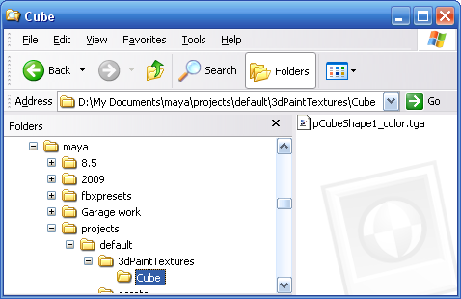
Using the 3D paint tool:
Step 3: Saving/Baking a Texture
Whether the texture was painted on or created through some other way, we are now ready to save its appearance on the model to a file.
  Bring back the side panel for the 3D Paint tool
      Scroll to the ‘File Texture’ section
  Click on ‘Save Texture’
    Maya will now save this image into the main Maya Project folder under the ‘3DPaintTextures/<model name>’ folder
    IMPORTANT: At this point, you saved the
    image but the model is NOT using it!

Slide 13
Using the 3D paint tool:
Step 4: Using the Saved Textures
Since the only way XNA can texture a model is by applying a texture image to it, we must make sure that this is what Maya is currently doing.
Furthermore, this must be done in a way that will also work with XNA
  Locate the image file you save in the previous step and copy it into your MyContent\Models folder.
      Yes, in the Models folder since this image will be tightly linked to the model
  In Maya, open the hyper-shade view
  Create a new Lambert render node and double-click on it
  Click the black and white square to the right of the ‘Color’ slider
  From the render node menu, select ‘file’
  On the right, select your newly copied MyContent/Models/<image name>
  At this point, you have a render node ready to apply the image file onto your model.
  Select the model
  Move the mouse over the render node and right-PRESS (not right-click). You will see a context menu appear.
  Select ‘Assign Material to Selection’
  Voila! You finally have a model textured using the image file you created.

Slide 14
Using the 3D paint tool:
Step 4: Using the Saved Textures
Since the only way XNA can texture a model is by applying a texture image to it, we must make sure that this is what Maya is currently doing.
Furthermore, this must be done in a way that will also work with XNA
  Locate the image file you save in the previous step and copy it into your MyContent\Models folder.
      Yes, in the Models folder since this image will be tightly linked to the model
  In Maya, open the hyper-shade view
  Create a new Lambert render node and double-click on it
  Click the black and white square to the right of the ‘Color’ slider
  From the render node menu, select ‘file’
  On the right, select your newly copied MyContent/Models/<image name>
  At this point, you have a render node ready to apply the image file onto your model.
  Select the model
  Move the mouse over the render node and right-PRESS (not right-click). You will see a context menu appear.
  Select ‘Assign Material to Selection’
  Voila! You finally have a model textured using the image file you created.
Models Using Multiple Shapes
In most cases, your models will be composed of more than one primitive shape.
    A render node can be applied to multiple primitives
    If you need multiple textures, then you will need to repeat “Step 1” through “Step 4” for each texture!!!

Slide 15
Using the 3D paint tool:
Step 5: Exporting your Model
To get our models into the game, they must be exported into the FBX format
  EDIT > Delete All By Type > History
  Save the .ma file into MyContent/Models
  Select the model and click on File/Export Selection
    Make SURE to EXPORT INTO THE MyContent/Models
      The fbx file MUST be in the same folder as the image file(s)
    Type in the correct name for your model
    Select the fbx file type
  That’s it! You finally have something XNA can use!

